Slide 1


Phishing Attacks: A Comprehensive Guide to Staying Safe
Welcome to this comprehensive guide on phishing attacks! In today's digital age, phishing scams are a pervasive threat, with cybercriminals constantly devising new ways to exploit unsuspecting individuals. This presentation will equip you with the knowledge and skills to recognize and avoid phishing emails, websites, and social engineering tactics. We'll explore the anatomy of a phishing email, the red flags to watch out for, and the best practices for protecting yourself online. By understanding the tactics used by phishers, you can safeguard your personal and professional information from falling into the wrong hands.

Slide 2
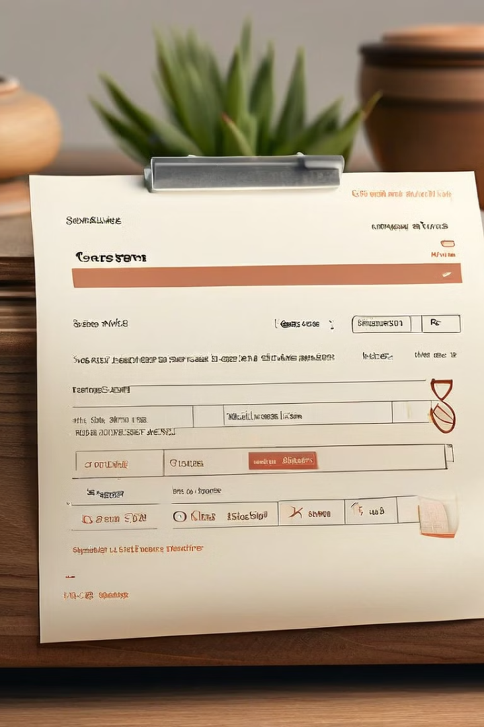
Understanding the Anatomy of a Phishing Email
1
Subject Line
2
Sender Address
Phishing emails often use attention-grabbing or alarming subject lines designed to trigger a sense of urgency or fear. They might claim to be from a legitimate organization, such as your bank or a government agency, or they might use sensational headlines to lure you in.
The sender address of a phishing email may appear legitimate at first glance, but it's crucial to examine it closely. Phishers often create spoofed addresses that closely resemble real email addresses. Look for subtle differences in spelling or domain names.
3
Email Body
4
Links and Attachments
Phishing emails typically contain a compelling narrative designed to entice you to take a specific action. They may ask you to update your account information, confirm a transaction, or claim a prize. The text often includes a sense of urgency, using phrases like "immediate action required" or "limited time offer."
The most dangerous elements of a phishing email are often its links and attachments. Phishers use these to redirect you to malicious websites or to deliver malware to your computer. Never click on a link or open an attachment from an unknown or suspicious sender.

Slide 3
Recognizing Phishing Websites and URLs
Domain Name
Website Layout
Security Certificates
Phishing websites often use domain names that closely resemble legitimate websites. Look for slight misspellings, extra characters, or domains that are not the expected domain for the organization. For example, a phishing website for a well-known bank might use a domain name like "bankofamerica.com1" instead of the legitimate "bankofamerica.com."
While some phishing websites may be sophisticated, many have a less polished and unprofessional look compared to legitimate websites. Look for inconsistencies in design, graphics, or the overall appearance of the site. A phishing website might have misaligned text, blurry images, or an overall lack of attention to detail.
Legitimate websites use security certificates to encrypt the data transmitted between your browser and the website, ensuring that your information is protected. When you visit a secure website, a padlock icon will appear in your browser's address bar. If you see a padlock icon with a warning message, or if the website does not have a security certificate at all, it's a strong indicator that you might be on a phishing website.

Slide 4

Social Engineering Tactics in Phishing
Scarcity and Urgency
Authority and Trust
Phishers often create a sense of urgency and scarcity by claiming that a limited-time offer or a special promotion is available only for a short period. They might use phrases like "act now" or "limited availability" to pressure you into making a decision without fully considering the risks.
Phishers often try to build trust by impersonating legitimate organizations or individuals. They might use official logos, professional-looking emails, or even create fake websites that mimic real ones. They might also use fear tactics by claiming that your account has been compromised or that you are at risk of identity theft.
Curiosity and Intrigue
Personalization and Targeting
Some phishing emails exploit people's curiosity by offering enticing offers, such as free gifts, discounts, or exclusive content. They might use catchy subject lines or intriguing images to pique your interest and make you more likely to click on the link or open the attachment.
Phishing attacks are becoming increasingly personalized and targeted. Phishers often collect information about their victims through social media or data breaches and use it to create more convincing and effective phishing emails. This information might include names, addresses, and even recent purchase history.

Slide 5
Protecting Yourself from Phishing Scams
Be Skeptical
1
Always be skeptical of emails or websites that ask for personal or financial information, especially if they seem unexpected or urgent. Take your time to examine the email carefully and consider whether the request is legitimate.
2
Verify the Sender
Hover over links before clicking to see the actual URL destination. If the URL appears suspicious, do not click it. Also, check the sender's email address for spelling errors, typos, or inconsistencies.
Don't Click Suspicious Links
3
Never click on a link or open an attachment from an unknown or suspicious sender. If you are unsure about the source of an email or website, contact the organization directly using a known phone number or website.
4
Use Strong Passwords
Create strong, unique passwords for each of your online accounts. Avoid using personal information in your passwords, and consider using a password manager to help you create and remember strong passwords.
Enable Two-Factor Authentication
5
Two-factor authentication adds an extra layer of security to your accounts by requiring a second form of authentication, such as a code sent to your phone, in addition to your password. This makes it much harder for phishers to access your accounts, even if they have your password.

Slide 6

Identifying Suspicious Email Headers and Sender Information
Sender Address
Look for subtle differences in spelling or domain names. For example, "amazon.com1" instead of "amazon.com".
Subject Line
Pay attention to subject lines that are overly generic, urgent, or alarming. Examples include "Urgent action required," "Account suspended," or "You've won a prize!"
Email Body
Be wary of emails with poor grammar, misspellings, or inconsistencies in formatting. Look for unusual phrasing or overly emotional language.
Links and Attachments
Hover over links before clicking to see the actual URL destination. Never open attachments from unknown senders or if you're unsure of the source of the email.

Slide 7
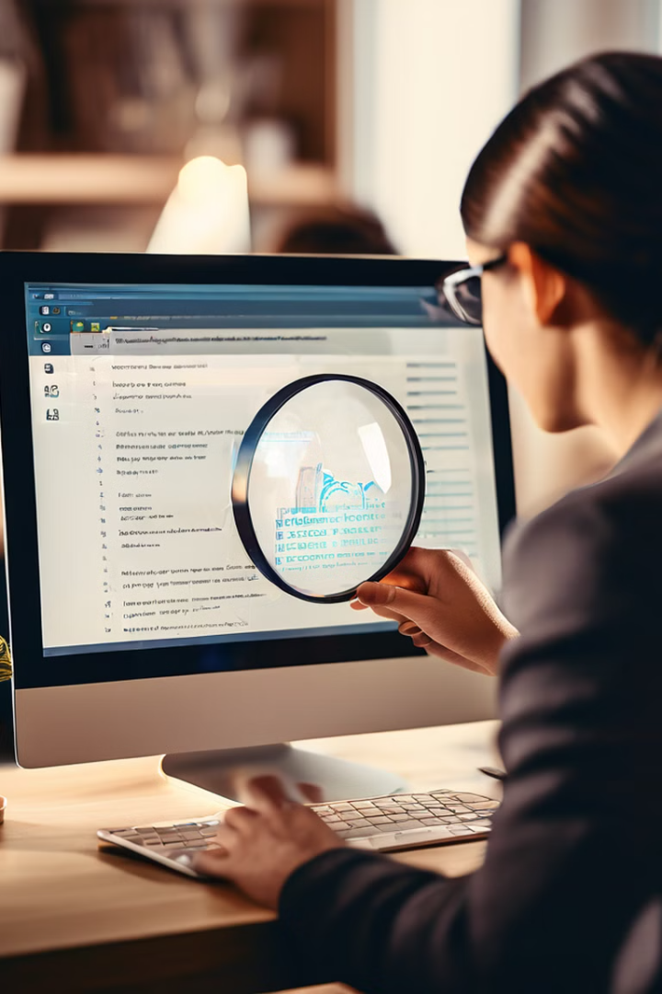



Verifying the Legitimacy of Email Requests
Contact the Organization Directly
If you receive an email requesting personal information or asking you to take an action, contact the organization directly using a known phone number or website. Verify that the request is legitimate before providing any information or taking any action.
Check for Official Communication Channels
Legitimate organizations usually have official communication channels, such as their website, social media pages, or official email addresses. Check these channels to see if there is any information about the request you received.
Report Suspicious Activity
If you suspect that you have received a phishing email, report it to the organization in question and to your email provider. You can also report phishing websites to the appropriate authorities.

Slide 8
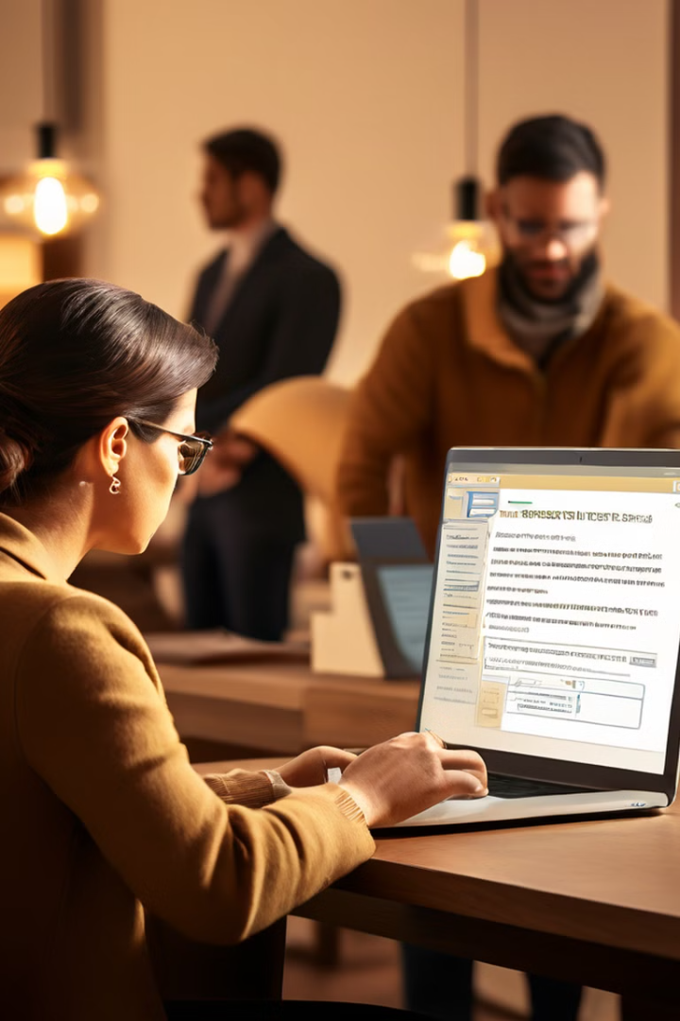




Reporting Suspected Phishing Attempts
Report to Email Provider
Report to Website Owner
Most email providers have mechanisms for reporting suspicious emails. Look for a "report spam" or "report phishing" button within your email interface. This will help prevent others from receiving the same phishing email.
If you encounter a phishing website, report it to the website owner or to the appropriate authorities. Some websites have a "report abuse" or "contact us" link that you can use to report the phishing website.
Contact the Anti-Phishing Working Group (APWG)
Report to Law Enforcement
If you believe you have been a victim of a phishing scam, you can report the incident to your local law enforcement agency.
The APWG is a global organization that works to combat phishing and other online scams. You can report suspected phishing attempts to the APWG through their website.

Slide 9

Best Practices for Secure Online Behavior
1
Keep Software Updated
2
Be Careful What You Share Online
Software updates often contain security patches that fix vulnerabilities that could be exploited by phishers. Make sure to update your operating system, web browser, and other software regularly.
Think carefully before sharing personal information online, especially on social media. Phishers can use this information to create more convincing and targeted phishing emails.
3
Use Strong Passwords
4
Be Aware of Your Surroundings
Create strong, unique passwords for each of your online accounts. Avoid using personal information in your passwords, and consider using a password manager to help you create and remember strong passwords.
When using public Wi-Fi, be extra cautious about accessing sensitive information. Public Wi-Fi networks are often less secure than private networks and could be vulnerable to phishing attacks. Consider using a virtual private network (VPN) to encrypt your traffic and protect your information.

Slide 10
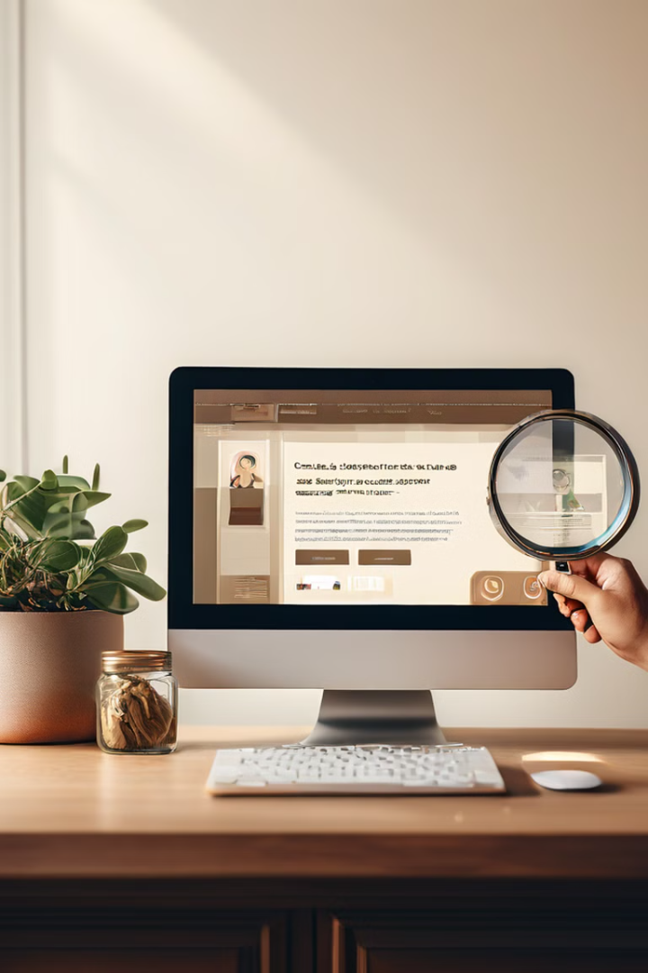
Conclusion and Resources
By implementing the best practices discussed in this presentation, you can significantly reduce your risk of falling victim to phishing scams. Remember to be vigilant, skeptical, and informed. By staying aware of the tactics used by phishers, you can protect yourself and your loved ones from these online threats. For further information and resources on phishing attacks, please refer to the following websites:
US-CERT
Anti-Phishing Working Group (APWG)
Federal Trade Commission (FTC)

